Slide 1
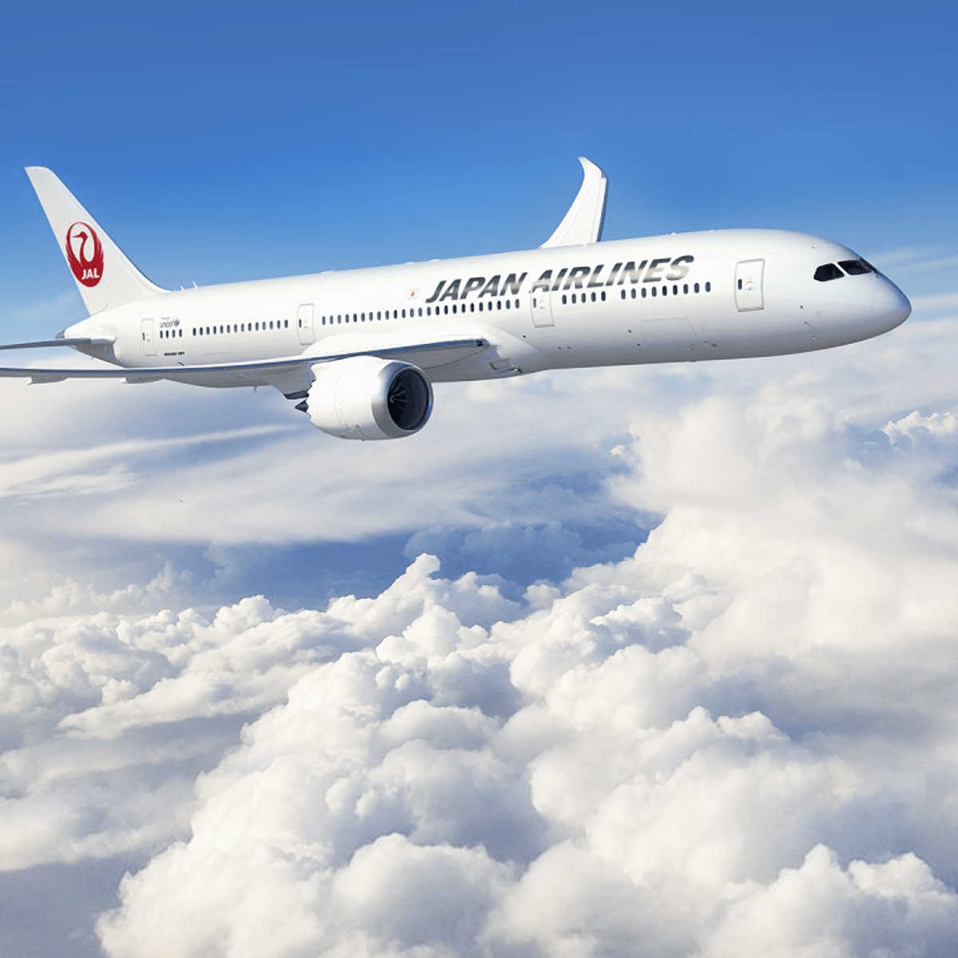
Airline Passenger Satisfaction
AIRLINE PASSENGER SATISFACTION ANALYSIS AND PREDICTION
Presented By: Karthi M
PRESENTED BY: KARTHI M
GUIDED BY: Prof. Nida Parker

Slide 2
PROBLEM STATEMENT
In this study the aim is to identify the level of satisfaction of the passengers to know the quality of services provided by the airline companies, the key factors that derive customer satisfaction and to identify the ways how the airline industry can improve the service quality.
Hence ,We are building a model to classify customer satisfaction level.

Slide 3
AGENDA
Introduction
Dataset
Exploratory Data Analysis
Data Visualization
Data Pre-processing
Model Building
Parameter-Tuning
Evaluation of the Model
Conclusion

Slide 4
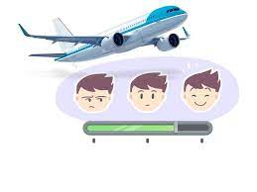

INTRODUCTION
Customer experience is always at the top of the priority list for airlines.
Customers that are dissatisfied or disengaged inevitably result in fewer passengers and less money.
It is critical that clients have a positive experience every time they travel.

Slide 5
DATASET
Source : Kaggle
Link : https://www.kaggle.com/datasets/teejmahal20/airline-passenger-satisfaction
Dataset Size : 103904 x 25

Slide 6
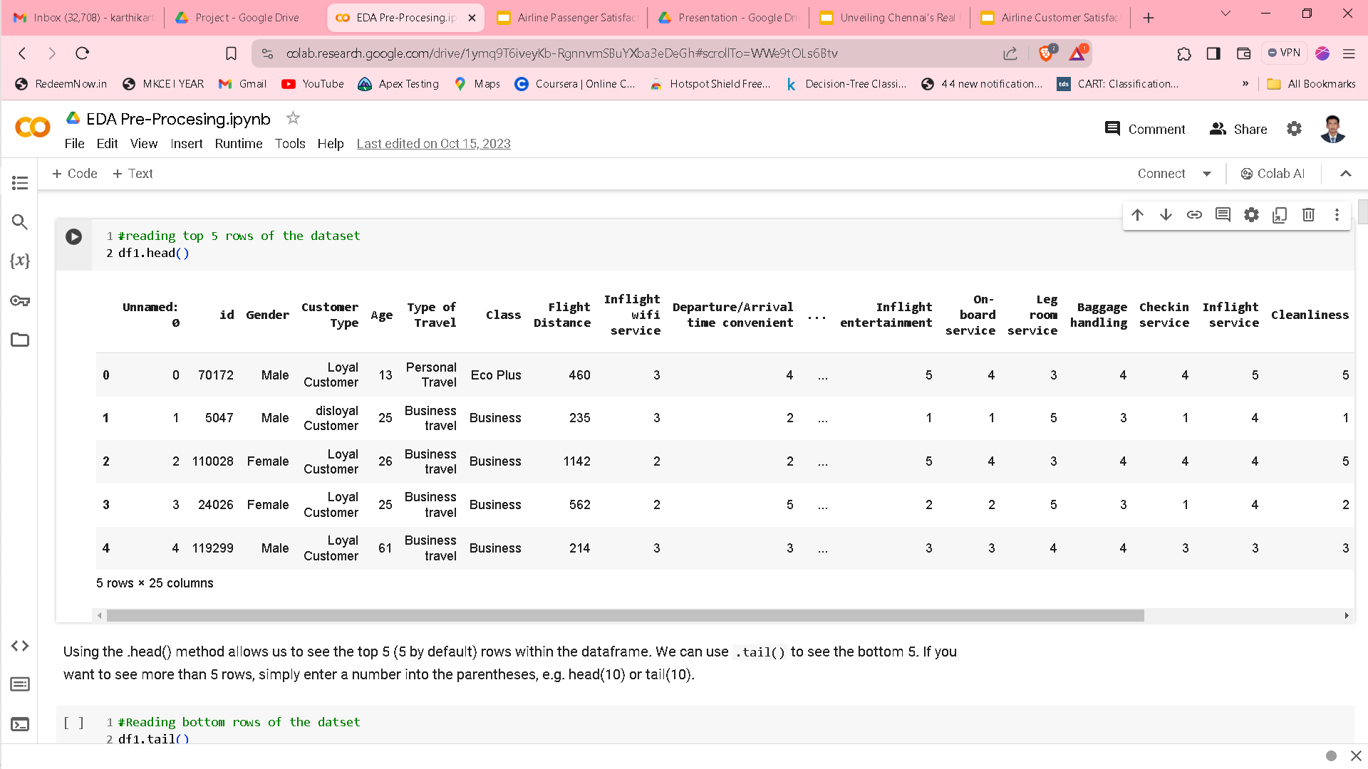
EXPLORATORY DATA ANALYSIS
Dataset

Slide 7
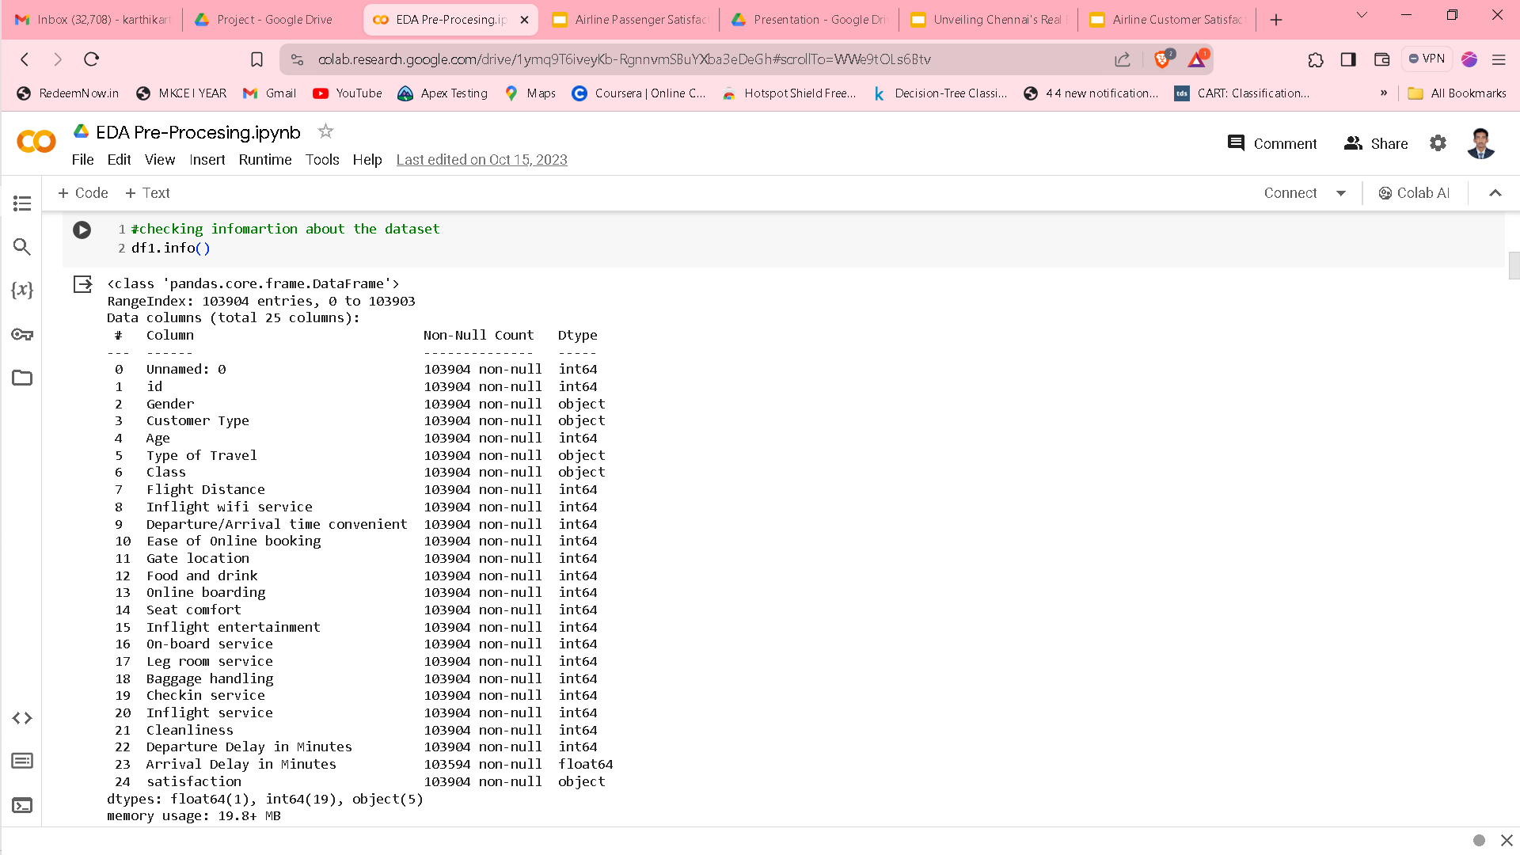
EXPLORATORY DATA ANALYSIS
Initial statistics :

Slide 8
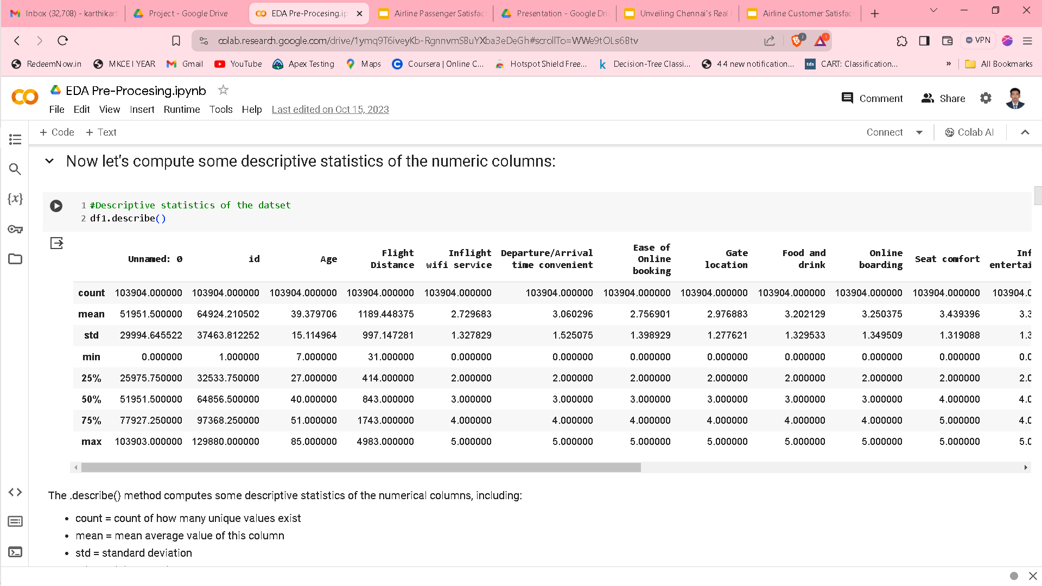
EXPLORATORY DATA ANALYSIS

Slide 9
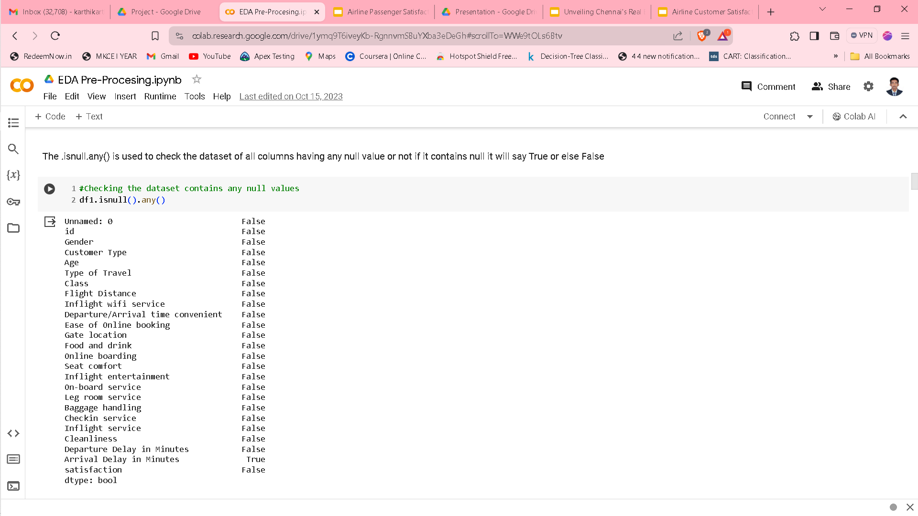
EXPLORATORY DATA ANALYSIS

Slide 10
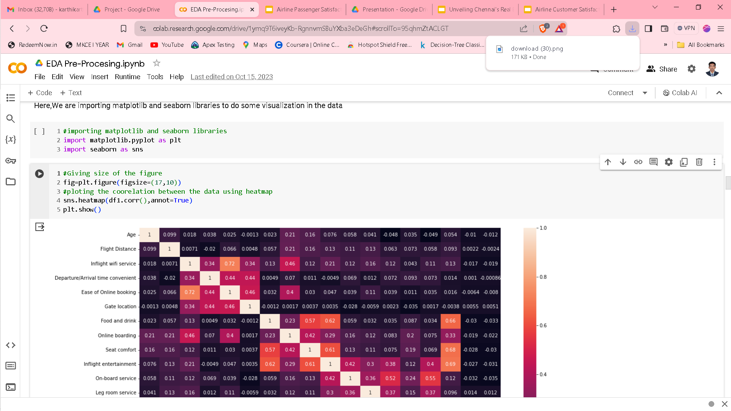
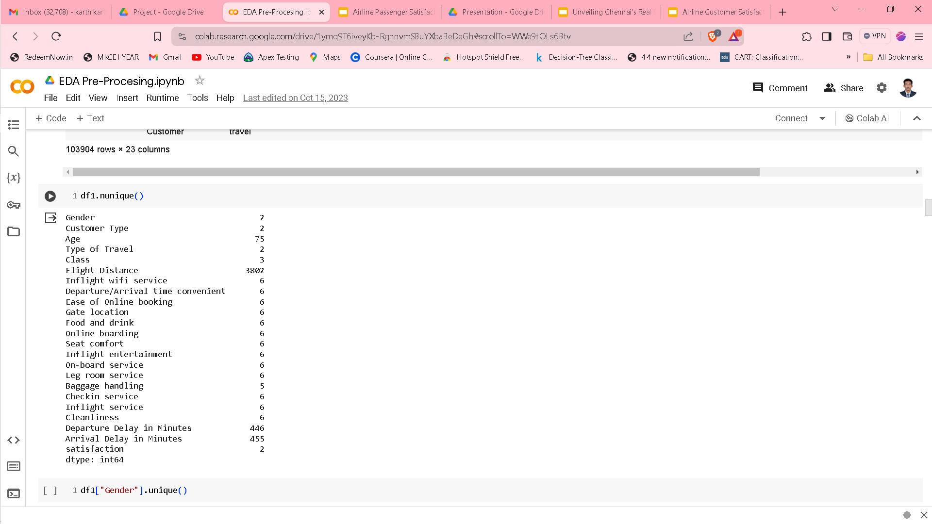
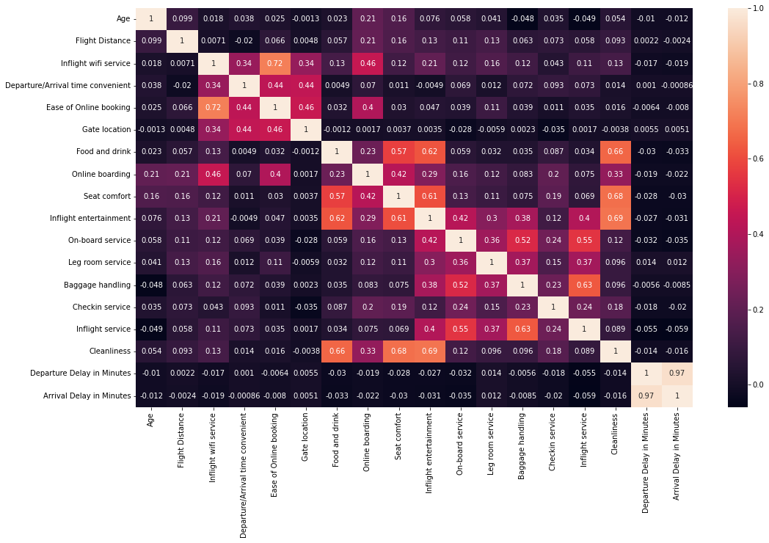
EXPLORATORY DATA ANALYSIS

Slide 11
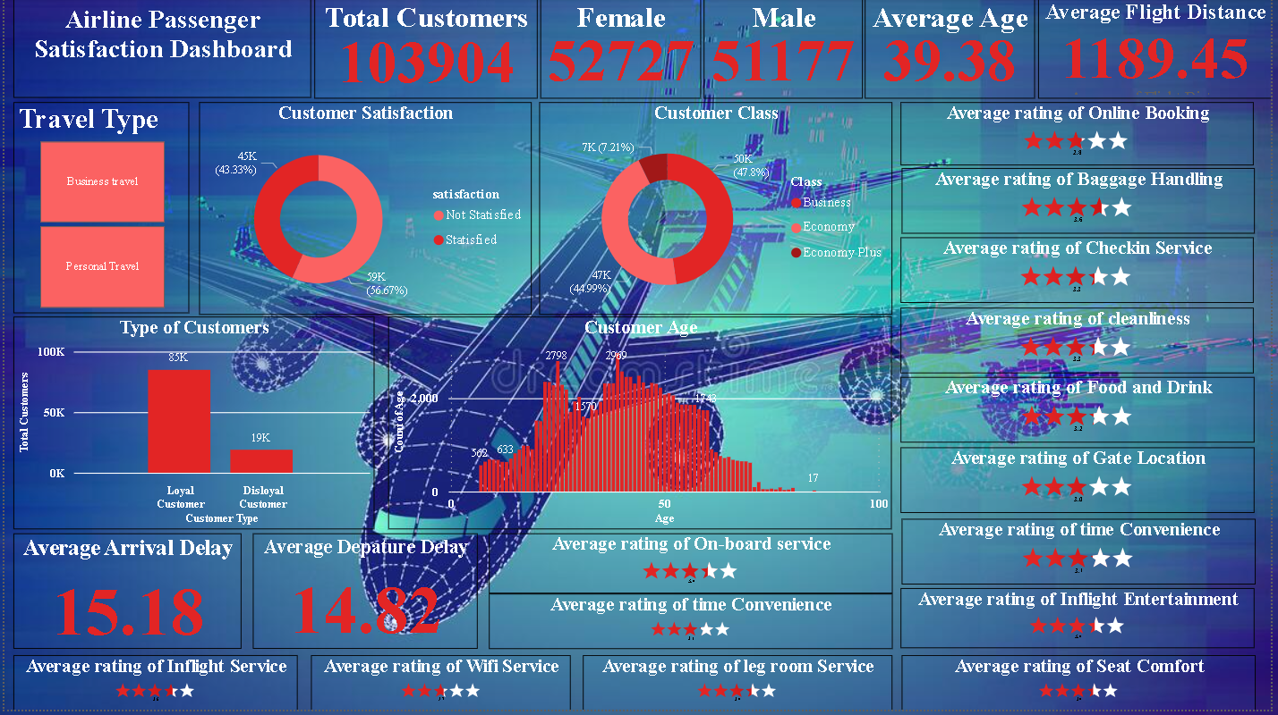
DATA VISUALIZATION

Slide 12
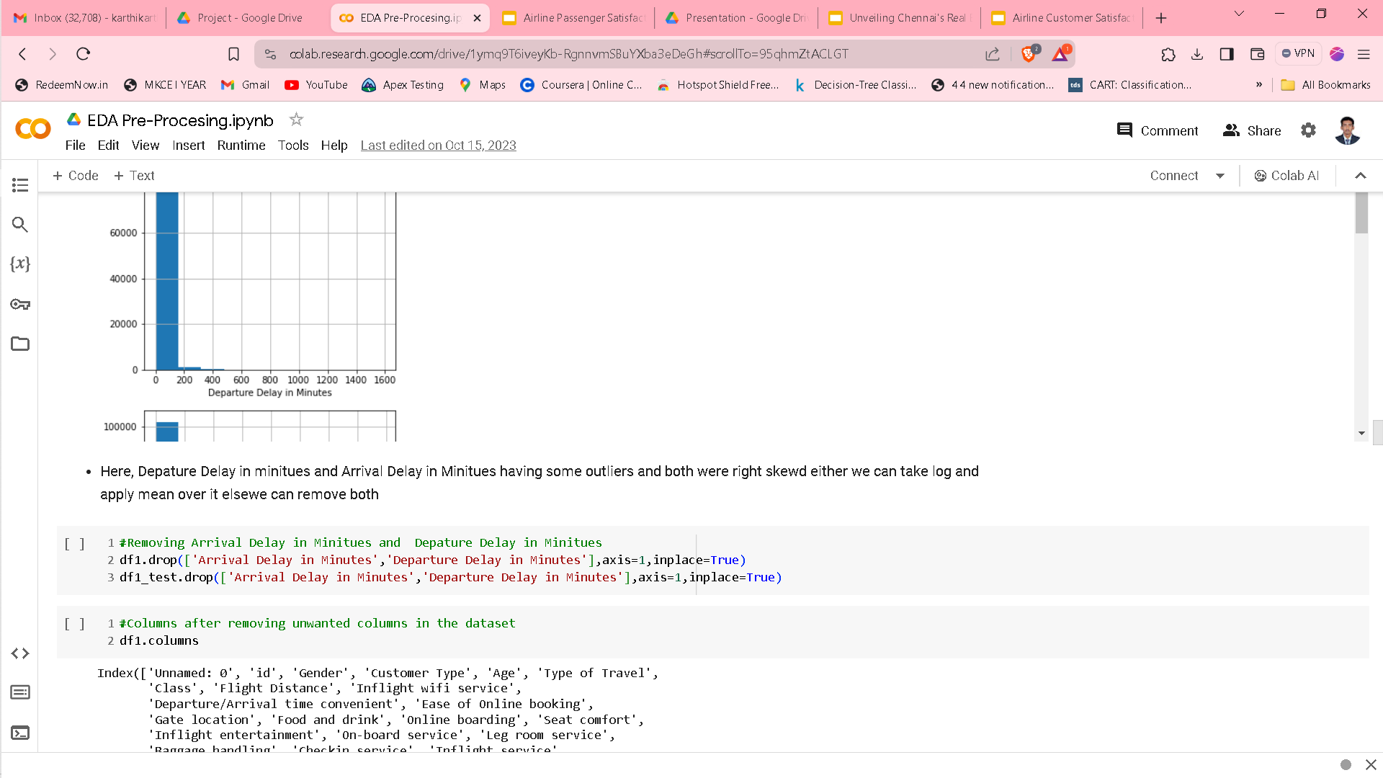
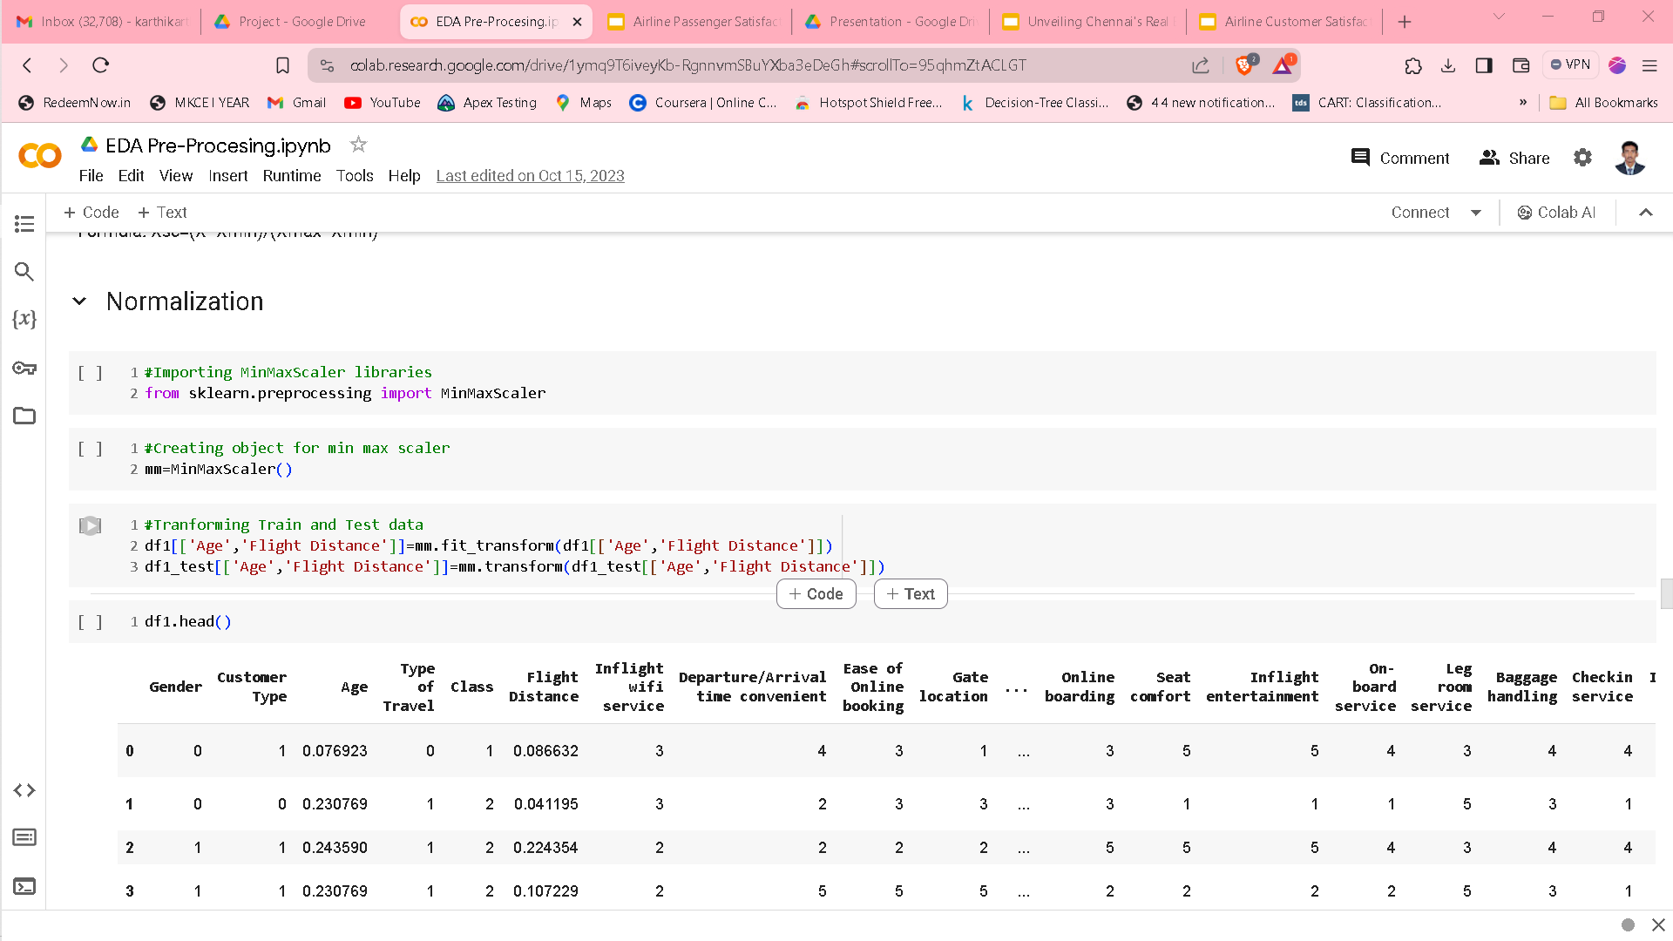
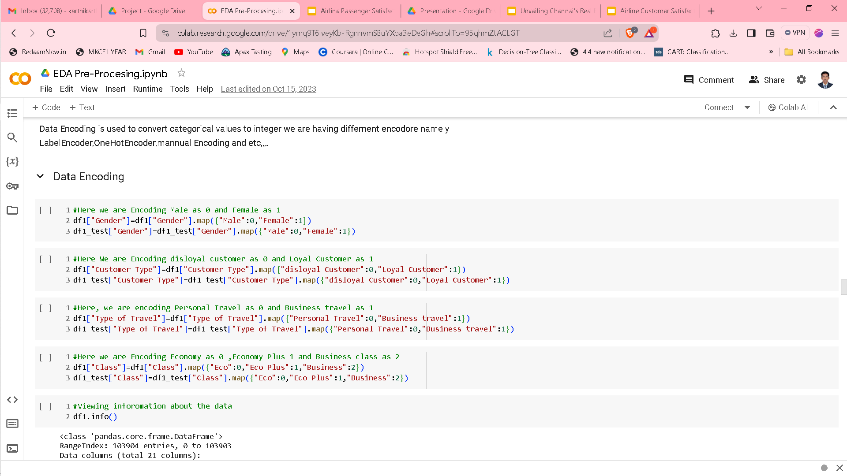
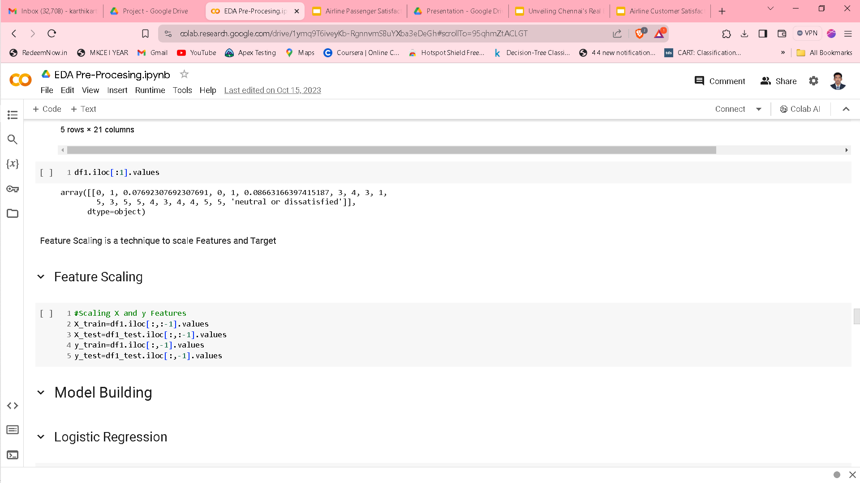
DATA PRE-PROCESSING

Slide 13
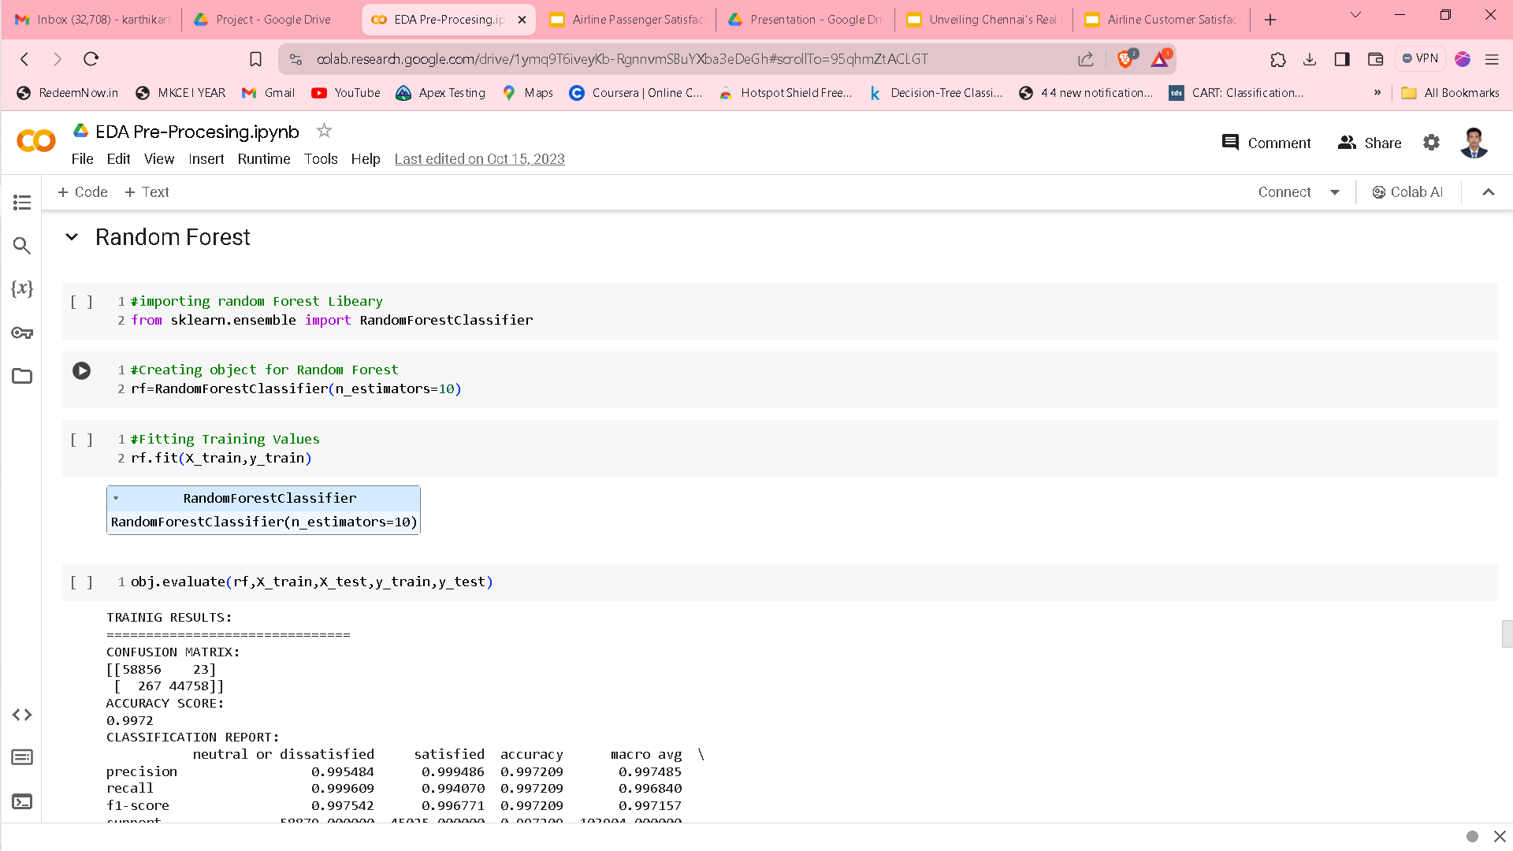
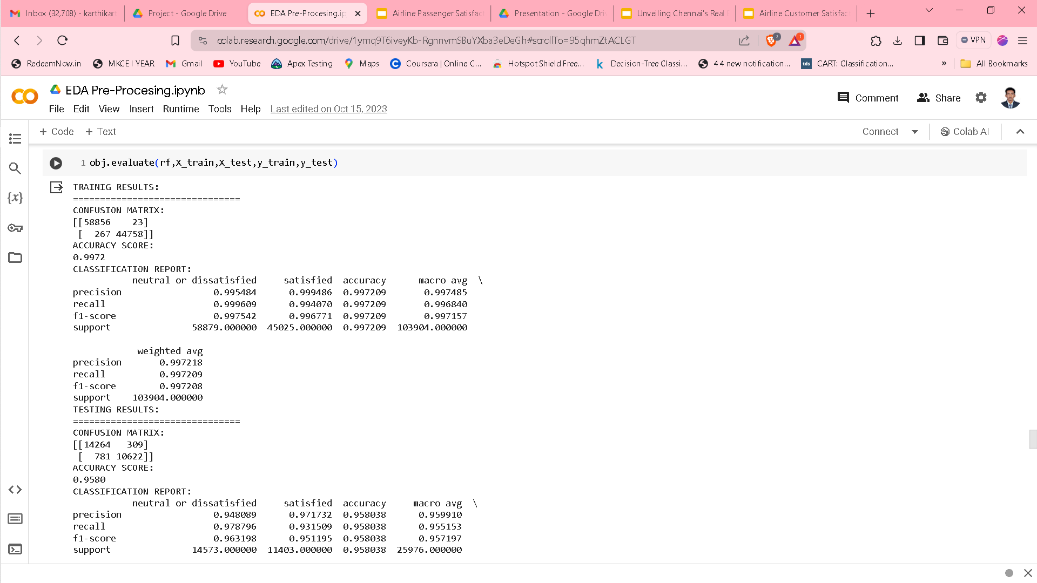
MODEL BUILDING

Slide 14
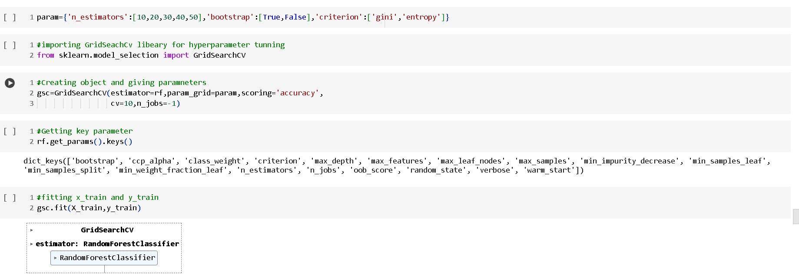
PARAMETER TUNING

Slide 15
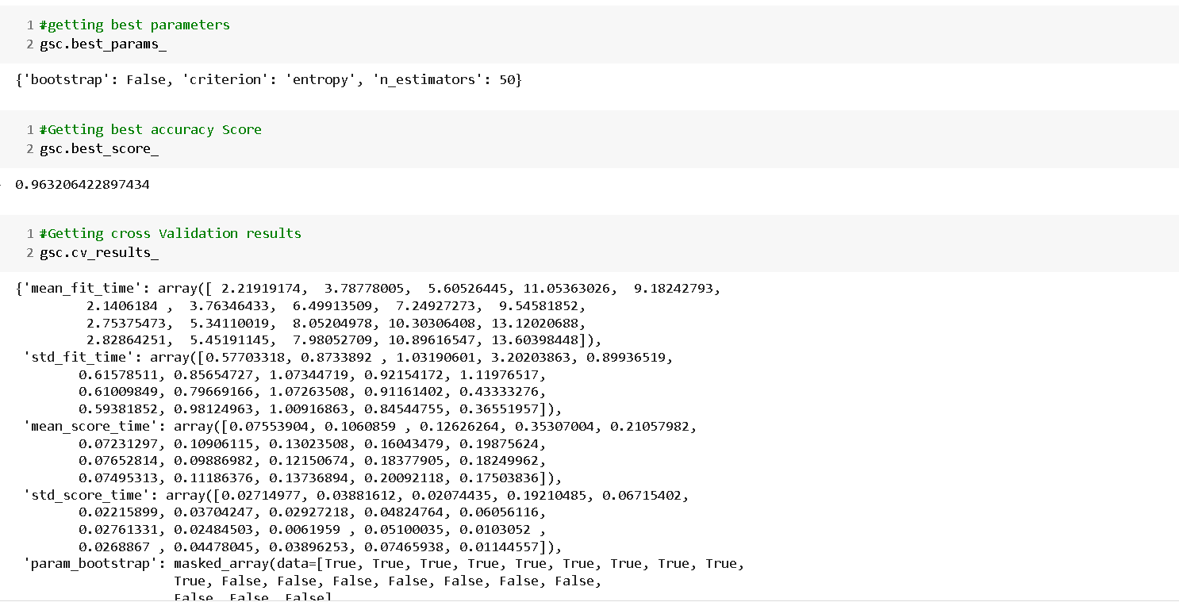
PARAMETER TUNING

Slide 16
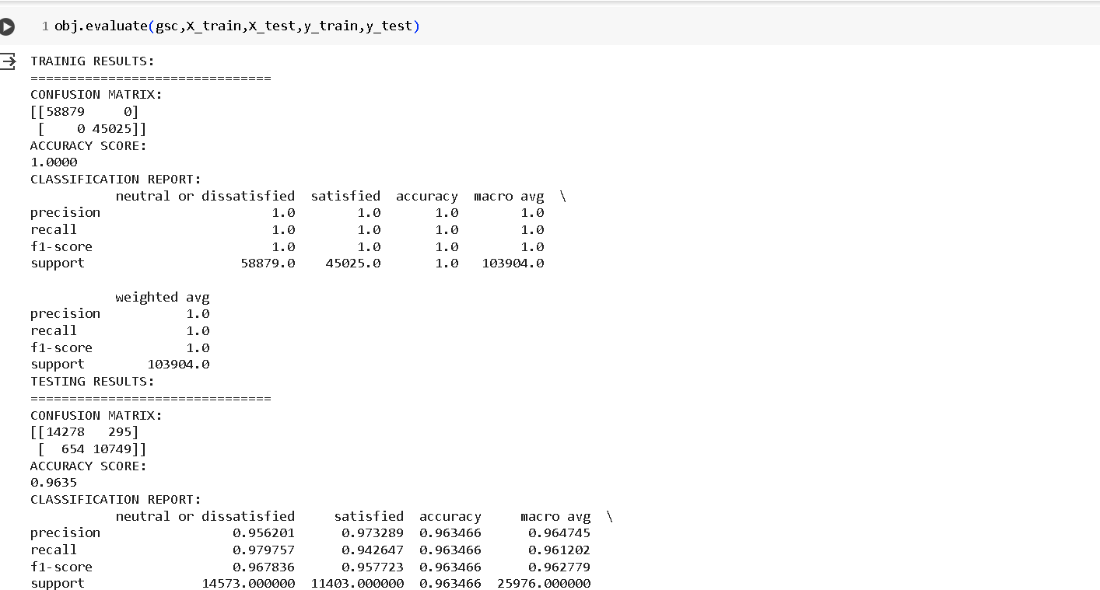
EVALUATION OF THE MODEL

Slide 17
CONCLUSION
We Concluded that Random Forest Model will gives the best accuracy of more than 96%.I want the model which giving best accuracy I will be taking that.
Algorithms | Accuracy
Logistic Regression | 87%
Decession Tree Classifier | 94.4%
Support Vector Machine Classifier | 94.6%
Random Forest Classifier | 95.8%
Random Forest Classifier after parameter tunning | 96.35%
Gaussian NaiveBayes Classifier | 86.42%
Voting Classifier | 95.82%

Slide 18
THANK YOU ☺

